Slide 1
How to make a powerpoint
By Jeremy Ramirez

Slide 2
Hitting the main points of the PPT (Good)
When talking about the main point of the powerpoint
It is good to follow the rule of 4
Which is atleast four points on a page
So the viewer can understand them
Notes:
Starting off, Hitting the main point of the powerpoint
When talking about the powerpoint,it is good to follow the rule of 4 so the reader can understand you.

Slide 3
Hitting the main points of the PPT (Bad)
Do
Not
Make
multiple
Bullet
Points
For
No
Reason
Notes:
This is the same topic as before, but the bad portion. It is important to not make bullet points for no reason

Slide 4
Contrast (Bad)
The font color should compliment the color of the background.
It could discourage the reader from reading your PowerPoint
Notes:
For bad contrast, the font color should complement the background, if not, it will discourage the reader from it

Slide 5
Contrast (Good)
This is what a good contrast looks like
If one puts a dark background, it is good to put a light font (Vice-Versa)

Slide 6
Good Bullets
It is good to put the bullet points on the left side
It is also good to have them be parallel to each other

Slide 7
Bad Bullets
This is what a bad bullet point looks like
It is not parallel with the rest of them
It is confusing to the reader

Slide 8
showcasing data, info, etc.
If one showcased data, it is important to give it the most space possible
Like this
Notes:
What most people have trouble when making a powerpoint is where to put pictures. For example if one is showcasing data, give it the most space possible

Slide 9
showcasing data, info, etc.
Or like this!

Slide 10
Good background
The idea of a background is so it compliments not only the font, but also the graphic images if needed
One could stay with the usual format (Like this)
Or something different, as long as it follows the same form or color scheme

Slide 11
showcasing data, info, etc.
Or like this! (Form is the same, but different color)

Slide 12
Good background
Or you could do a PowerPoint background like this!
(color scheme is similar!)
Notes:
Or what you could do is add a background that has similar colors, but the form being different

Slide 13
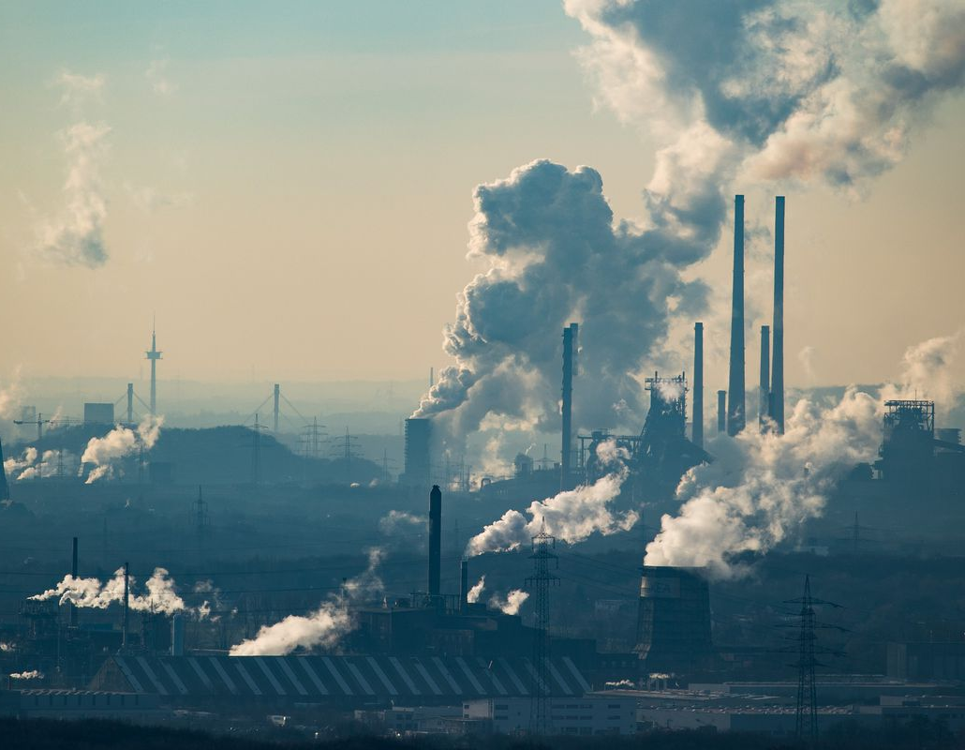
Good Graphics
If placing graphics, it should get the point across.
For example if the PowerPoint was about climate change

Slide 14
Bad Graphics
If placing a graphics, it should get the point across and should not be stretched out or pixelated.
For example if the PowerPoint was about climate change

Slide 15
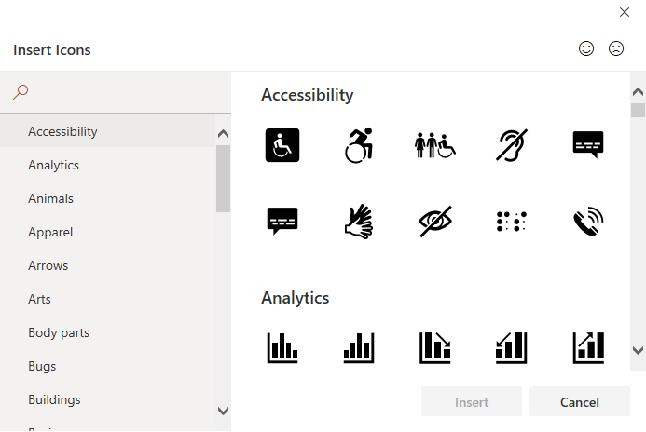
Icons (Good)
A good set of icons can be found easily in PowerPoint.
Click on the Insert tab and on illustrations, there is a icon button

Slide 16
Icons (Bad)
It is best to not use over the top images such as clipart as its been used for mostly every PowerPoint
Notes:
Now for the bad icons, its not good to use these icons because theyu have been overused and everyone has seen them

Slide 17
knowing your audience, assume audience doesn't know your topic
Assume your audience does not know anything that is in you PowerPoint.
It is important to showcase information as if they were seeing it the first time.
Example, If one is in economics class and is talking about trade agreements
don’t only say NAFTA, say North American Free Trade Agreement (NAFTA)

Slide 18
How to do a Questions slide (Only Icons)
Notes:
Lastly, how to do a question slide. It’s simple, you would put a icon question mark to show to the audience your taking questions.

Slide 19
Contact Information
Name: Jeremy Ramirez
Office: STEM Center (room 100)
Email: jramirez1166@alamo.edu
Notes:
Thank you for listening to me, here is my information if you would like to email me for any questions.

