Slide 1
Creating Math Steps
Algebra, Formulas and Math Operations

Slide 2
Writing Steps must use simple Language
Avoid steps like “use the formula”, “plug in the numbers”, “solve”
This doesn’t tell the students how to do anything, it would be like being told “work this calculus problem”, but you haven’t taken calculus.
What you need to do is tell them where to get the numbers from, how to write them down, which math operations to do first, second, …, how and where to put the answers.
The following slides show simple wording that can be used as math steps to tell the students how to do various mathematical operations.

Slide 3
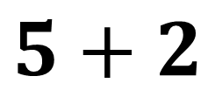
Addition Problems
$$5+2$$
First number plus the Second number
Add the two numbers
The sum of the two numbers
The total of the two numbers
Add the first and second number
Add the second number to the first
The first number increased by the second

Slide 4
Subtraction Problems
$$5−2$$
First number minus the Second number
The difference between the two numbers
Subtract the second number from the first
The second number less than the first
The first number decreased by the second

Slide 5
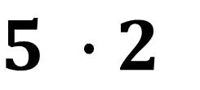
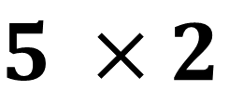
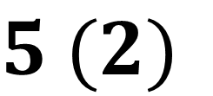
Multiplication Problems
Notations:
$5 ×2$
$5 ∙2$
$5 (2)$
Multiply the first by the second number
The first times the second number
The product of the two numbers
The product of the first and second number

Slide 6
Division Problems
$$5÷2$$
The first number divided by the second number
The second number divided into the first
The quotient of the first and second numbers
The ratio of the first and second number
Notice that we are using the simplest version of the division symbol. Elementary students don’t learn long division until 4th grade, so you can’t use those symbols until they have reached that level of math

Slide 7
Formulas
Remember that little kids can’t use formulas, use powers or fractions and they do not know how to do order of operations.
When writing math steps for formulas, think about the order of operations.
Which part of the equation will be calculated first,
Where do they look in the problem or the question to find those numbers?
Which part of the equation will be calculated next, etc.
Each new operation should be a separate step.

Slide 8
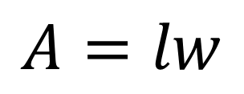
Geometry Formulas
Area is equal to the length times the width
$$A=lw$$
Steps: Find the length and width from the problem (or picture) Multiply the length times the width Write the answer with the units squared

Slide 9
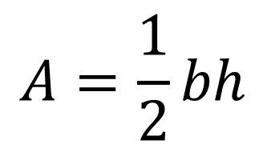
$$A=\frac{1}{2}bh$$
Area is equal to the base times the height divided by 2
Steps: Find the base and height from the problem (or picture) Multiply the base times the height
Divide that number by 2 ***
Write the answer with the units squared
***Since they can’t do fractions, the wording must be simplified to multiply by the top and divide by the bottom number. This formula has a “1” on top, so it can be skipped in the steps.

Slide 10
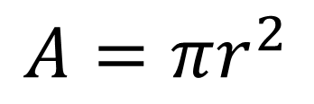
$$A=πr^{2}$$
Area is equal to 3.14 x radius x radius
Steps: Find the radius from the problem (or picture) Multiply radius times radius ***
Multiply that number by pi (3.14) Write the answer with the units squared
***Since they can’t do powers, it must be simplified to repeated multiplication.
They also cannot do pi, so either they must be given the actual value or you need to show them how to find the “pi” button on a calculator.

Slide 11
Algebra Expressions
Little kids also can’t do Algebra (i.e. anything with a variable (a letter) in it, like “x”). For algebra problems, you have to call the variable by an everyday name.

Slide 12
Algebra Steps
Example Problem: Bobby has twice as many marbles as Ginny. How many marbles does Bobby have if Ginny has 8 marbles?
We begin by describing the math problem using words instead of the variables:
(Bobby’s marbles) = 2 x (Ginny’s marbles)
step 1: Write down the number of marbles Ginny has in the space provided
(Bobby’s marbles) = $2 (8)$ step 2: Calculate 2 x (Ginny’s marbles)
(Bobby’s marbles) $=16 marbles$ step 3: Write the answer in the answer space

Slide 13
Teaching an alternate method
It is a hard enough task to teach well-known methods, but when the method you have to teach is new to you also, then it has to be broken down, defined, outlined and explained in even more detail than usual.
See the following example of a shortcut method for multiplying numbers by 11 to see how much extra detail is required.

Slide 14
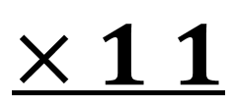
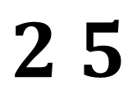
Title: Multiply a 2-digit number by 11
Tens digit of “other number”
Ones digit of “other number”
$$2 5$$
$$×1 1$$
The “11”
hundreds
tens
Ones
FIRST GIVE STUDENTS THE DEFINITIONS AND STRUCTURE YOU WANT THEM TO USE

Slide 15
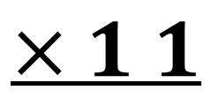
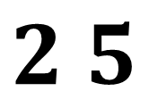
Title: Multiply a 2-digit number by 11
Tens digit of “other number”
Ones digit of “other number”
$$2 5$$
EACH MATH STEP TELLS THEM WHICH NUMBER TO USE FIRST, WHAT MATH OPERATIONS TO DO WITH THEM AND WHERE TO WRITE THE ANSWERS
$$×1 1$$
The “11”
hundreds
tens
Ones
1. Find the TENS place on the “other number”
2. Write that number in the “hundreds” place of the answer
3. Find the ONES place on the “other number”
4. Write that number in the “ones” place of the answer
5. ADD the two digits of the “other number” together
6. Write that number in the “tens” place of the answer

Slide 16
Title: Multiply a 2-digit number by 11
Tens digit of “other number”
Ones digit of “other number”
NOTE: If step 5 gives you a 2-digit number, write down the ones digit and “carry” the tens digit, adding it to the hundreds place
$$2 5$$
$$×1 1$$
The “11”
2
7
5
1. Find the TENS place on the “other number”
2. Write that number in the “hundreds” place of the answer
3. Find the ONES place on the “other number”
4. Write that number in the “ones” place of the answer
5. ADD the two digits of the “other number” together
6. Write that number in the “tens” place of the answer

Slide 17
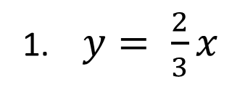
Practice Problems
Create a set of math steps for the following problems.
1. $y= \frac{2}{3}x$
Sam has 3 more red candies than Jerry. Jerry has 5 red candies. How many red candies does Sam have?
Post your steps on the assignment page for a grade

